Slide 1
ECO346 · DATA VISUALIZATION FOR ECONOMISTS
Who pays for school,
and who can read?
Education spending and the gender literacy gap in rural Balochistan, PSLM 2019–20
VARIANT
STUDENTS
PERSONS 10–64
STUDENT
6
1,464
5,677
Areeba Tahir
Balochistan, rural
ed_total > 0
literacy recorded
FA24-BEDS-014
Notes:
Variant 6 (14 = 1 x 8 + 6): rural Balochistan. Data: PSLM 2019-20 person file merged with the household file by hhid; every statistic is weighted by hhweight. Two questions: how much do households spend per student, and how does literacy differ between women and men across age groups.

Slide 2
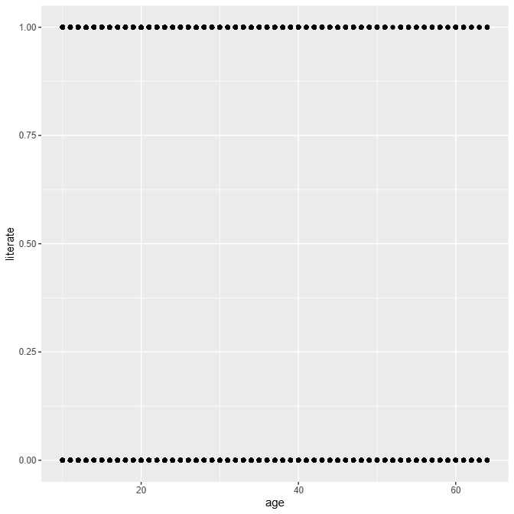
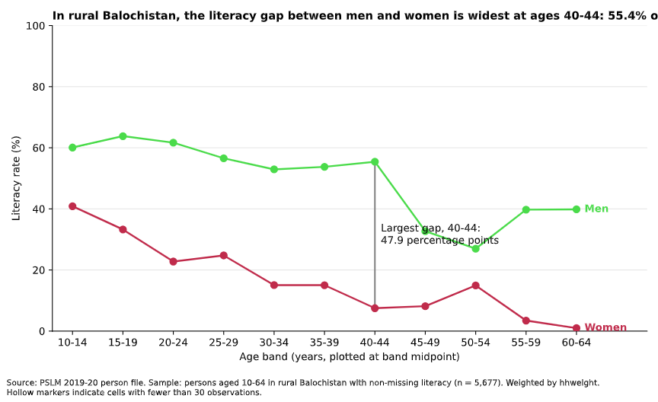
Makeover: raw dots become a clear comparison
BEFORE
AFTER
Conditional means
Five-year bands replace overplotted 0/1 points
Two labelled series
Women and men compared directly, no legend
Gap annotated
Eye is led to 40–44: 47.9 points
1
2
3
Notes:
Before: R's untouched geom_point of literate against age. The outcome is only 0 or 1, so points overplot and say nothing about women versus men. After: weighted conditional means by five-year age band, one series per sex, direct labels, largest gap annotated. What the default shows that the redesign hides: the individual observations and the raw 0/1 outcome.

Slide 3
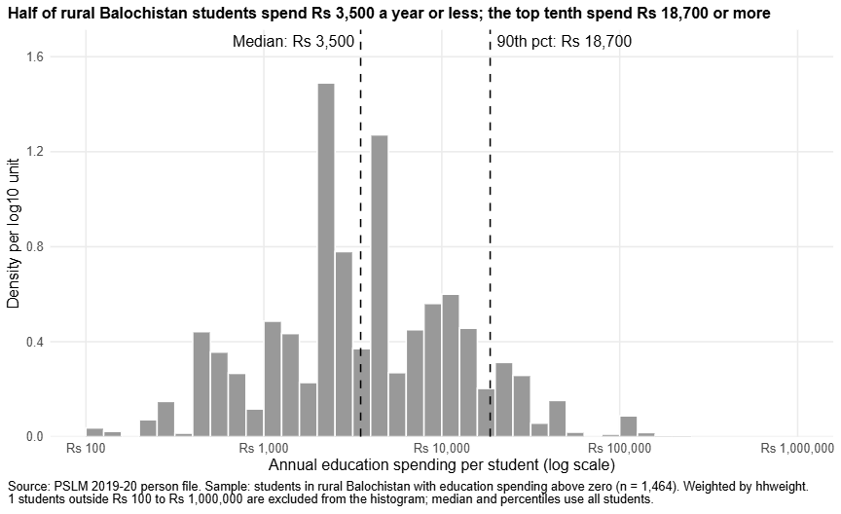
Half of students cost Rs 3,500 a year or less; the top tenth cost Rs 18,700 or more
Rs 3,500
weighted median annual spending per student
Unweighted median
Rs 3,000
10th percentile (weighted)
Rs 600
90th percentile (weighted)
Rs 18,700
90th ÷ 10th ratio
31.17
Excluded from histogram
1 of 1,464
Weights count the households each student represents.
Notes:
Weighted histogram, log10 bins 0.1 wide, density per log10 unit. Weighted median Rs 3,500 vs unweighted Rs 3,000: weights count how many households each observation represents. 90th percentile Rs 18,700, 10th Rs 600, ratio 31.17. One student lies outside Rs 100 - Rs 1,000,000 and is excluded from the histogram only.

Slide 4
Key finding: men out-read women in every age band, most of all at ages 40–44
47.9
Weighted literacy rate (%) by age band
percentage-point gap at 40 to 44: 55.4% of men vs 7.5% of women
Ages 15–19
33.3% women 63.8% men
Ages 55–59
3.5% women 39.7% men
Descriptive only: it cannot tell us why the gap exists.
Notes:
Weighted literacy, rural Balochistan, persons 10-64, n = 5,677. Women 15-19: 33.3% vs men 63.8%. Women 55-59: 3.5% vs men 39.7%. Largest gap: 40-44 at 47.9 points. This is descriptive and cross-sectional, so it cannot establish causes or separate age effects from generational differences.

